Slide 1
BUILDING AND MAXIMIZING YOUR PERSONAL BRAND
MADELINE ADAMO: DIGITAL CONTENT STRATEGIST
KELLY MCGRAIL: DIRECTOR OF DIGITAL MARKETING AND ANALYTICS

Slide 2
WHAT IS A PERSONAL BRAND?
Personal branding is a popular buzz word, but what does it really mean?
Notes:
Kelly

Slide 3
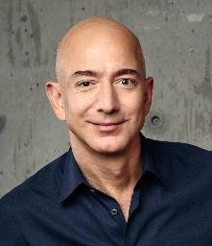
“Your brand is what other people say about you when you’re not in the room.”
~Jeff Bezos, Amazon
Notes:
Kelly

Slide 4
YOUR BRAND
Whether you believe it or not, you already have a brand.
Your brand is your reputation. It is about bringing who you are to what you do and how you do it.
What do you want to be known for?
What are your unique strengths, skills, and attributes?
How do you interact with the world about you?
Notes:
Kelly

Slide 5
THINK OF YOURSELF AS A PRODUCT
E-A-T
EXPERTISE Leverage data from authoritative sources
AUTHORITY Highlight your credentials
TRUST become the source (video, social, Facebook Lives, authorship, blogging, guest blogging, etc.)
These days, the best products are purpose driven. Bringing purpose into your brand helps you gain the trust of your audience.
Notes:
MADELINE

Slide 6
WE ALL HAVE ATTITUDES AND BELIEFS ABOUT BRANDS BASED ON OUR EXPERIENCES.
The strongest brands are:
Powerful
Authentic
Consistent
Visible
Valuable
THE SAME QUALITIES APPLY TO PERSONAL BRANDS.
Notes:
Kelly: Think about some of your favorite brands – what sets them apart from other brands?

Slide 7
WHAT IS YOUR CURRENT BRAND?
Notes:
Madeline

Slide 8
EXERCISE: ASK YOURSELF
What makes you special?
What are your greatest strengths?
What differentiates you from others?
How does your uniqueness translate to value?
What are your most significant accomplishments?
What do people come to you for?
What do you want to be known for?
What do you want others to think when they hear your name?
Notes:
Don’t forget to seek feedback!
Is the perception of others consistent with your perception of yourself?
Talk to trusted colleagues.
Use 360-degree surveys, if possible.
Review past performance reviews.

Slide 9
HOW DO YOU STRENGTHEN YOUR BRAND?
Notes:
What is your goal?
Who is your target audience?
How does your current brand position you to achieve your goal?
Do you need to make any changes?

Slide 10
MAKE ADJUSTMENTS
Fill gaps
Education
Experience
Relationships
Begin to act the part
Introduce yourself
Speak the language
Share your story
Notes:
KELLY

Slide 11
70% Of people are irritated by the use of inappropriate jargon or slang by brands
Source: Survata
Notes:
MADELINE

Slide 12
SHOWCASE YOUR BRAND
Notes:
Build influential relationships.
Get involved in cross-functional projects.
Use volunteering to strengthen or develop skills.
Take on a leadership role in a relevant organization.
Start a website or blog.

Slide 13
HOW DO YOU LEVERAGE SOCIAL MEDIA?
Notes:
MADELINE

Slide 14
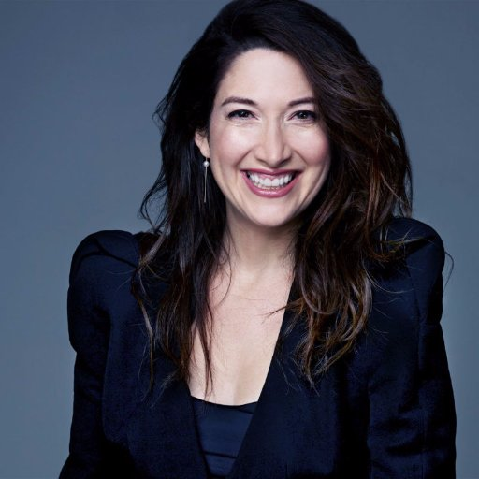
“These days, brands are media companies.”
~Randi Zuckerberg, Facebook
(We’d make this argument for personal brand, as well)
Notes:
MADELINE

Slide 15
Strategy
Do something that feels scarce. Stay on brand.
Reduce, reuse, recycle content.
Alternate between sharing and posting original content
Establish authority by sharing relevant content to your brand and adding a quote or comment (the more content you author, the more you’ll show up in Google searches)
Try new things on social! The next time Facebook or Instagram launches something new, make it your point to be on the platform. (Except Instagram TV… it’s not going to happen)
Notes:
MADELINE
What about your post will make people pause? Share?

Slide 16
DON’T FORGET…
DID YOUR AUDIENCE INCLUDE TIME TRAVELERS?
Future hiring committees, employers, colleagues, students, policy makers, etc….
Social media audience > target audience
Notes:
KELLY

Slide 17
CONSTRUCTING A PERSONA
Treat your social media personality like an audience who also happens to have your CV….
Notes:
KELLY

Slide 18
EXERCISE: What business are you really in?
What would someone pay you $100/hour to tell/teach/inform them about?
What are you repeatedly telling/showing/explaining to your clients? What do they want more of from you? What are they always asking for?
What do you know about? What’s your knowledge base? What do you know that other people don’t?
How does your service/offering/product make people feel? What problem does it solve, or what state does it create?
Source; Danielle Laporte, The Fire Starter Sessions
Notes:
MADELINE

Slide 19
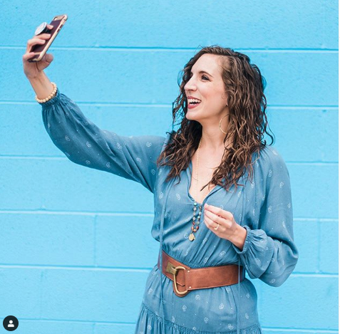
“Instagram Marketing is an interactive experience of your brand that is creatively presented and strategically planned in order to build a relationship with your audience.”
~Quinn Tempest, Instagram influencer
Notes:
MADELINE

Slide 20
How can I use Instagram to build my brand?
Your feed on Instagram is your landing page and should give our audience a quick glimpse at your brand.
Use Instagram Stories to share authentic, real-time captures of your brand.
Use Stories to create a personal, behind-the-scenes feel.
½ of all Instagram users are on Stories daily.
Stories help create scarcity, which is great for personal brand.
Notes:
MADELINE

Slide 21
HOW DO YOU MANAGE YOUR BRAND?
BE PROACTIVE
BE STRATEGIC
Notes:
KELLY
PROACTIVE:
Promote your accomplishments.
Maximize your participation in meetings and groups.
Communicate effectively.
Stay relevant.
STRATEGIC
Choose your associates wisely.
Have a positive attitude.
Dress and act the part.
Maintain a professional image online.

Slide 22
The pitch (AKA, your social bio)
Goldfish have an attention span of 9 seconds. Humans, only 8.
Brand and key message should be introduced in the first 3 seconds of your content/bio
Reaching people isn’t the challenge– It’s connecting with them.
Notes:
MADELINE

Slide 23
EXERCISE: Bio/Elevator pitch for social media
Try writing a “business obituary” for your career/personal brand in one short paragraph. Use some of the keywords that came up earlier.
Tease out the items from that obituary that you want to be most known for and write a one-sentence heading that you would like to have on your tombstone.
You now, more or less, have your social bio!
Notes:
MADELINE

Slide 24
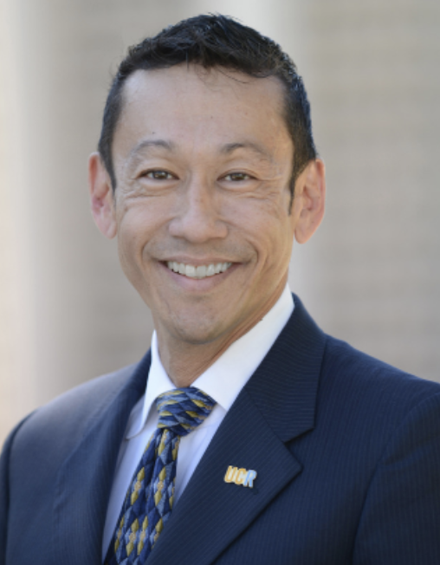
Parting words from Peter:
“Spend disproportionate time and energy on growing your self-awareness, curiosity, and professional brand. People never know themselves as well as they think they do, and unless they actively seek feedback, they won’t know what they don’t know.”
Notes:
both

Slide 25
QUESTIONS?

