Slide 1
Working Remotely
APPLYING ERGONOMICS
ANYWHERE YOU WORK

Slide 2
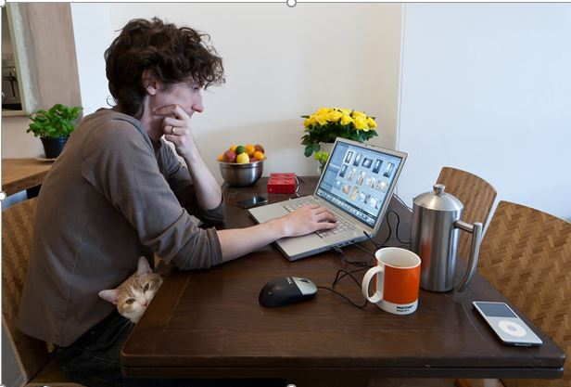
Notes:
Many people do not have dedicated work spaces at home, and the ergonomics of the chosen work area is poor.

Slide 3
Notes:
As poor working postures become uncomfortable we search for some other position or location of work to relieve discomfort. (The postures and work environments shown here are not good choices – but unfortunately, they are common.

Slide 4
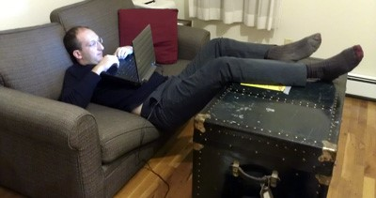
Notes:
If we don’t know what our best, preferred p=working postures are, we will likely move from bad to worse in our effort to find a comfortable working position.

Slide 5
What is “good” Ergonomic set-up ?
What are the principles?
Are they different at home than they are at the office?
What about other ‘remote locations’?
Notes:
A good “ergonomically correct” set-up, is ‘good’ because it will promote and allow for optimal postures. The body’s postural position is therefor the important issue and the thing to focus on!

Slide 6
Essential Elements of Good Working Posture
Standing and Seated:
Back Straight
Head Level (not looking down)
Upper arms hang relaxed at torso
Elbows about 90º
Feet well supported (on floor or footrest)
Seated Specific:
Lumbar curve is well supported
Torso rests against the back rest (sit deep-in-the seat)
https://hr.ucr.edu/document/whw-ergonomics-working-remotely
Notes:
These are the essential elements of good (ideal) posture. One should strive to adopt these postures as normal, consistent habit – at work, at home, even at play.

Slide 7
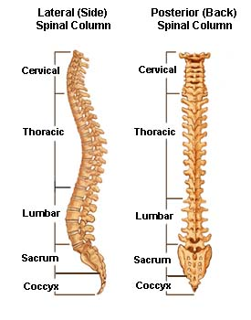
Notes:
The ideal postural position of the spine; from a profile view (left image) and straight on.

Slide 8
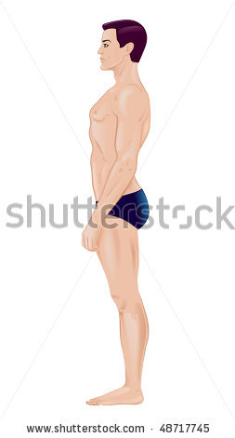
Power Posture of the Spine
The ears, shoulders and hips are in a straight line
Notes:
These curves are present when the ear, shoulder and hips are oriented in a straight line. This is the most stable, and powerful position of the spine, and is also the most relaxed position for the postural muscles of the torso and neck.

Slide 9
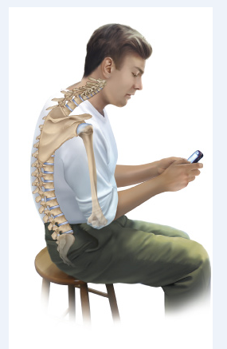
Notes:
When sitting, the hips come into flexion which causes a loss of the lumbar (low-back) curve, forward flexion of the neck, and rounded-back/slumped posture. (physically stressful)

Slide 10
3 Rules For Sitting Safely 1) Open Angles - (Raise Seat)
(open angle – preferred)
(90 degrees – acceptable)
Notes:
Maintaining an open angle at the hips helps to reduce physical stress in the low back – seek to keep the hips higher than the knees when sitting.

Slide 11
2) Sit “Deep-In-The-Seat”
Notes:
Maintain contact with, and support from, the backrest when seated – this reduces muscular effort from the postural muscles of the entire torso.

Slide 12
3) Support The Lumbar Curve !
Notes:
A support of the lumbar curve is essential to minimize muscular fatigue in the low-back when sitting for prolonged periods.

Slide 13
3) Support The Lumbar Curve !
Notes:
Always maintain a slight recline of the backrest (not perfectly vertical) so that the weight of the torso can “rest” against the backrest.

Slide 14
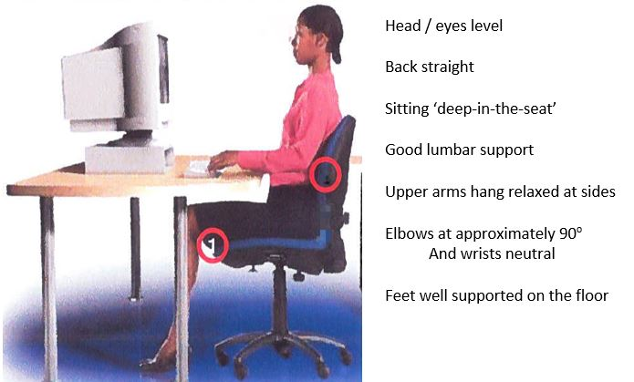
Notes:
The ideal seated posture and workstation set-up to promote same. Elements of the workstation are positioned to promote and facilitate the ideal posture,

Slide 15
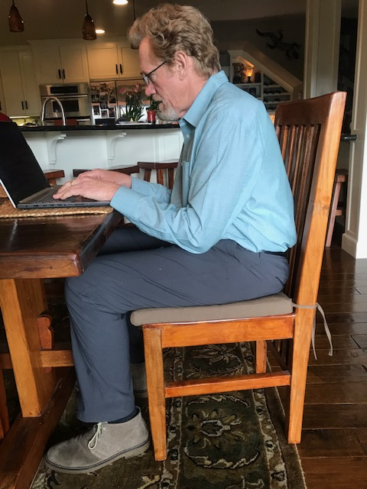
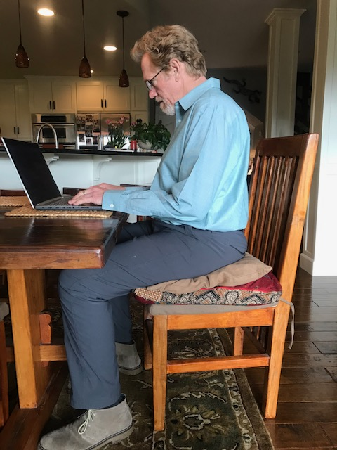
At The Dining Room Table
Notes:
Modify any work area to help promote better, preferable postures. The following slides progress from left to right. The goal is to achieve ideal (or close as possible to ideal) postures.

Slide 16
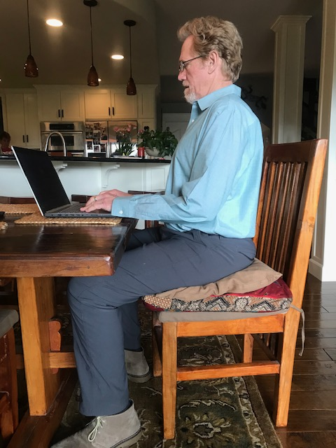
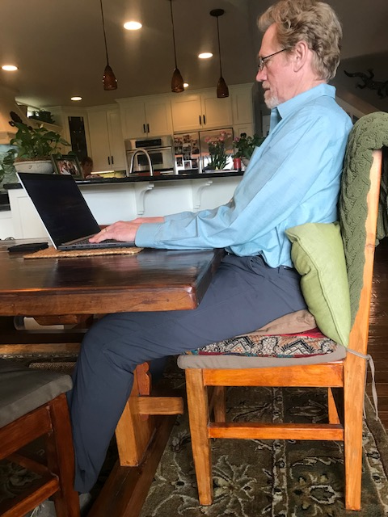
At The Dining Room Table
Notes:
Left: sitting up “straight” looks ideal but too much work without support from a backrest.

Slide 17
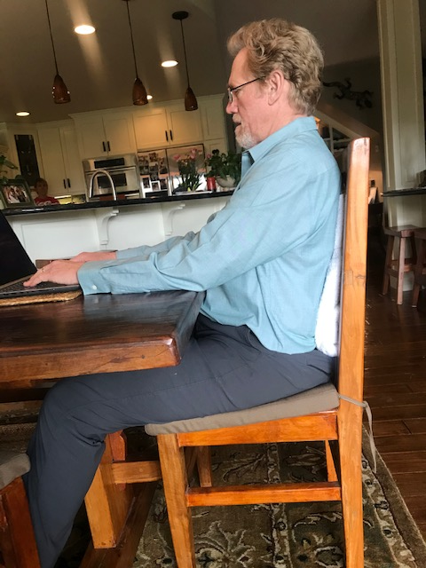
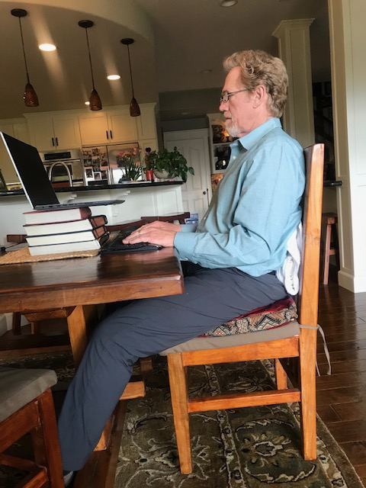
At The Dining Room Table
Notes:
Left: arms are forward but comfortably supported on the broad, flat surface of the table. Right: best possible set-up created with use of a remote keyboard and mouse.

Slide 18
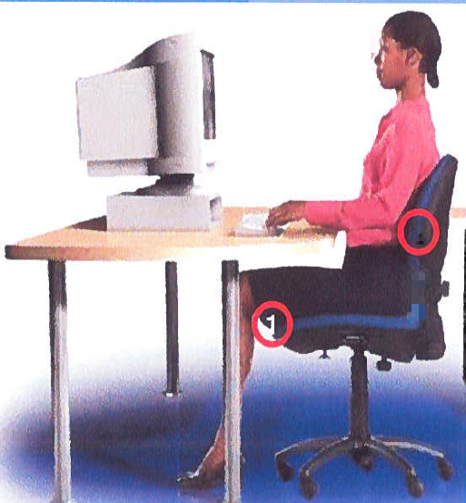
Notes:
“Essential Elements” of good posture are achieved.

Slide 19
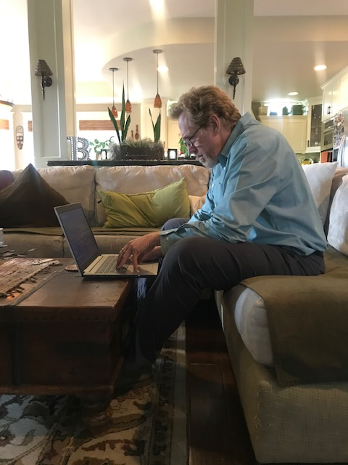
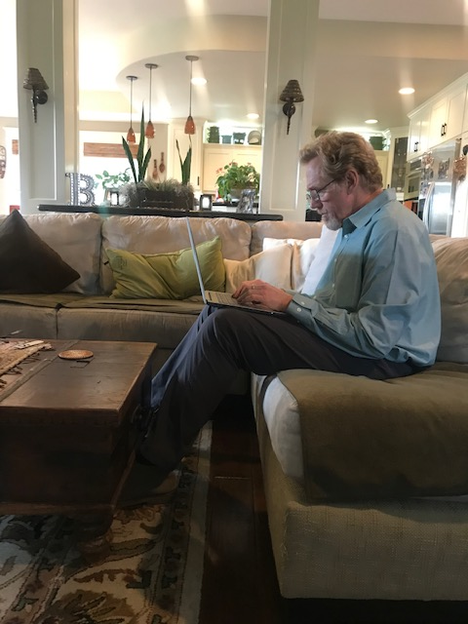
On The Couch (Ouch!)
Notes:
The couch is the worst seat in the house. Typically provides inappropriate support of the spine (or no support at all).

Slide 20
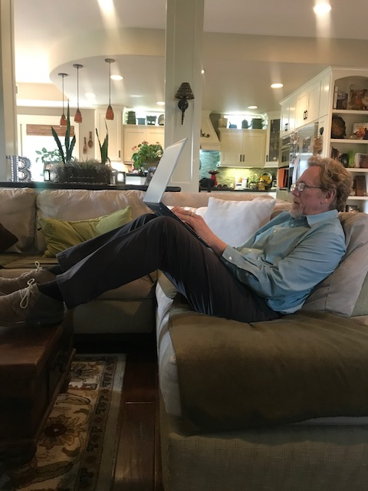
On The Couch (Ouch!)

Slide 21
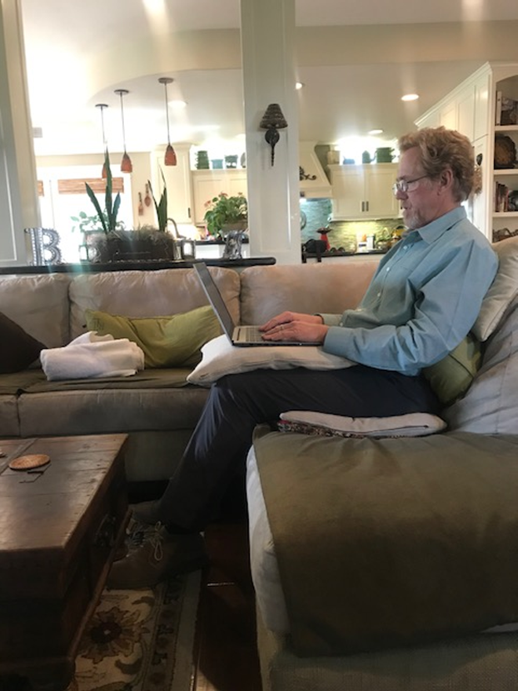
On The Couch
Notes:
Use of pillows to achieve preferred (or best possible) posture. Consider these modifications whenever spending time of the couch (watching TV, reading a book, hosting company).

Slide 22
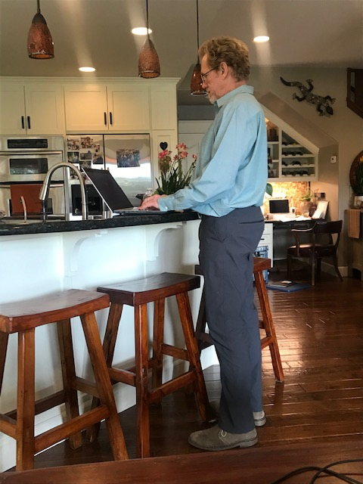
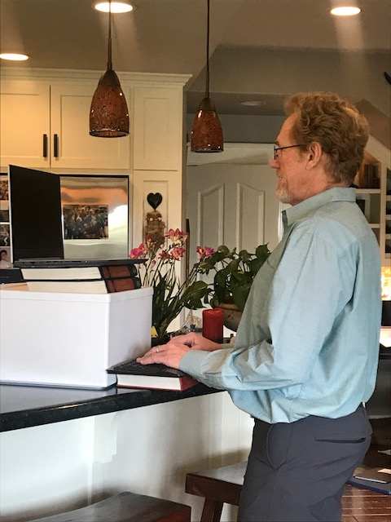
Creating Standing-work Options
Notes:
Give yourself options for working while standing. Modify to promote the “essential elements” of good posture.

Slide 23
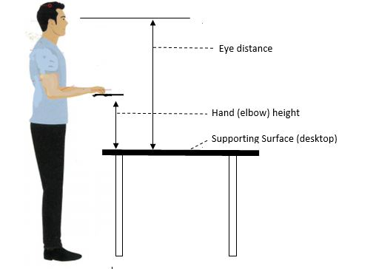
How To Remember - Keeping it Simple
Notes:
The placement (height) of the keyboard and monitor are critical to achieving a good standing workstation.

Slide 24
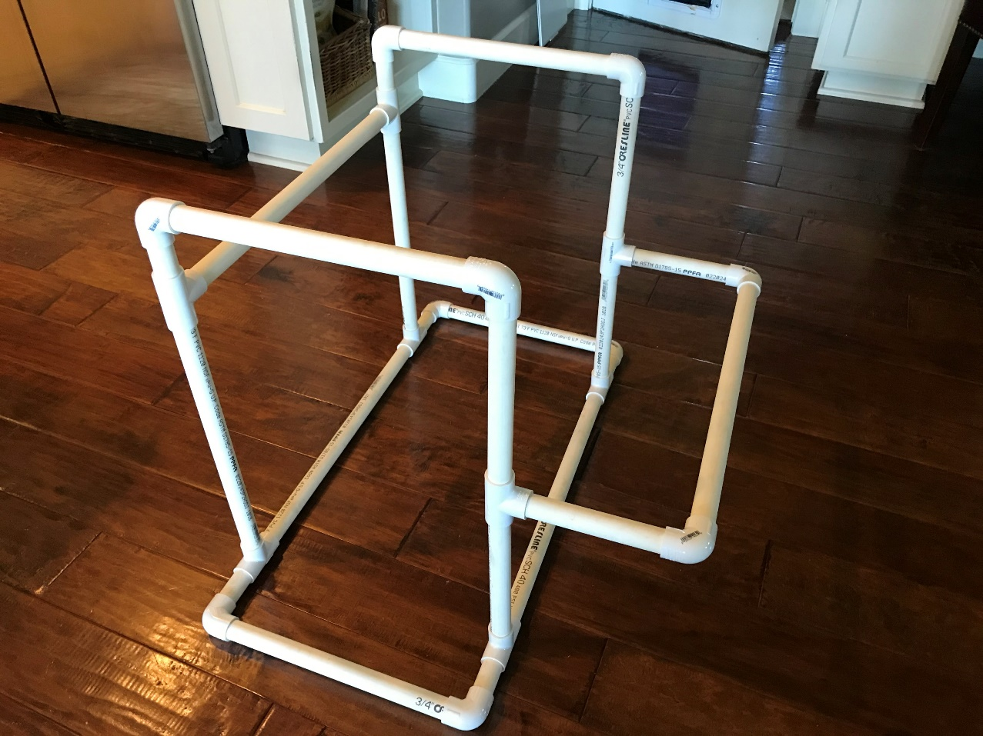
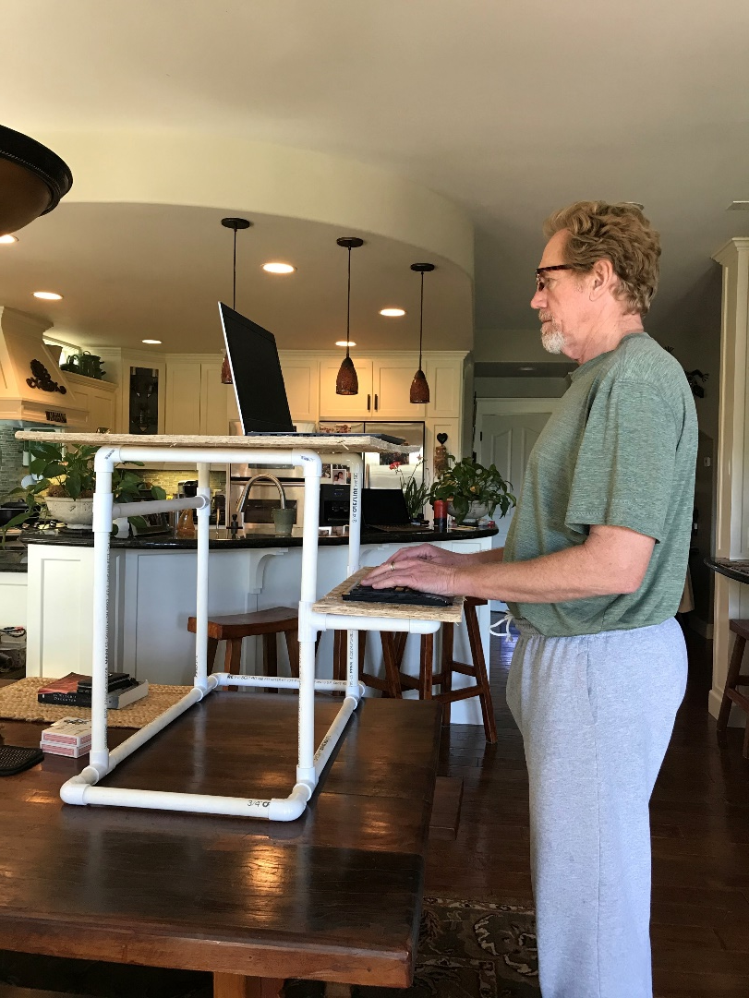
Build Your Own Standing Workstation?
Notes:
An example of how one might construct their own standing workstation.

Slide 25
STATIC POSTURES ARE STRESSFULL!
We Need To Move!
Notes:
Make a habit of incorporating stretching or other forms of movement throughout your workday.

Slide 26
STRETCHING GUIDELINES Stretch Opposite of Prolonged Postures Pay Attention to Pain! Breathe! Periodic and Frequent (Micro-break Stretching)
Notes:
Follow these guidelines and make micro-breaks frequent – i.e. every 45 minutes or so.

Slide 27
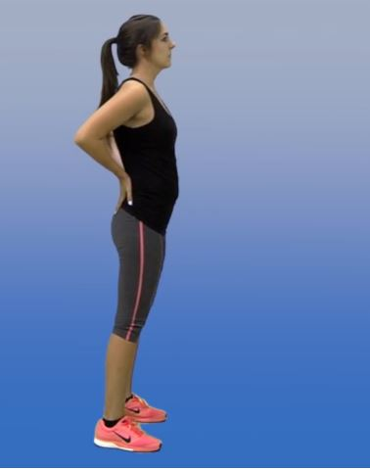
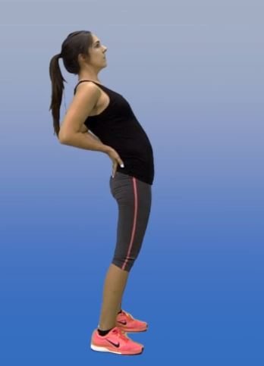
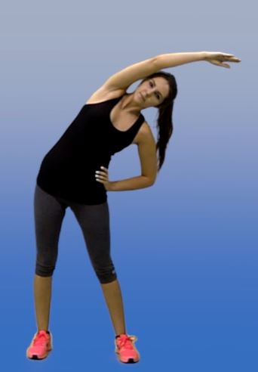
Back Extension Side Bend
Notes:
Movement in the “opposite direction” of the static posture we have been experiencing will be most productive at bringing recovery and reducing discomfort.

Slide 28
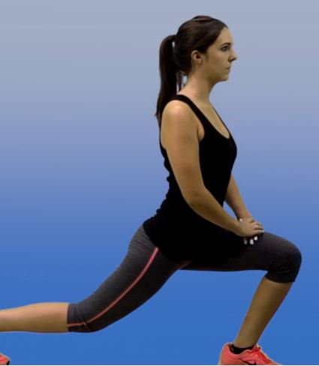
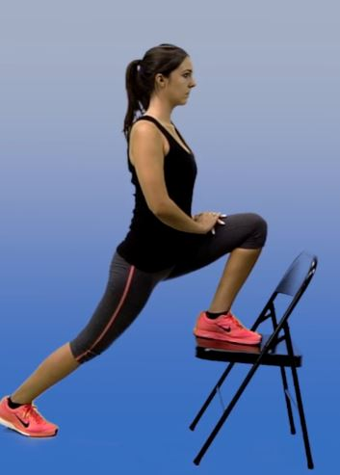
Hip Flexor Stretch
Notes:
Hip flexors are shortened and grow tight if we sit for prolonged periods.

Slide 29
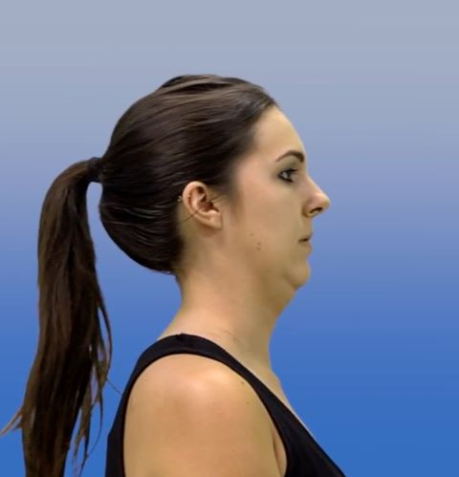
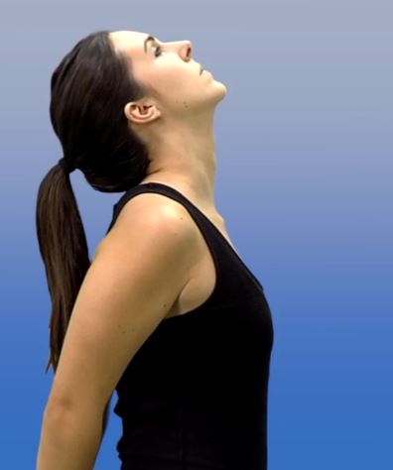
Chin Tuck Chest & Shoulder (Chin Retraction)

Slide 30
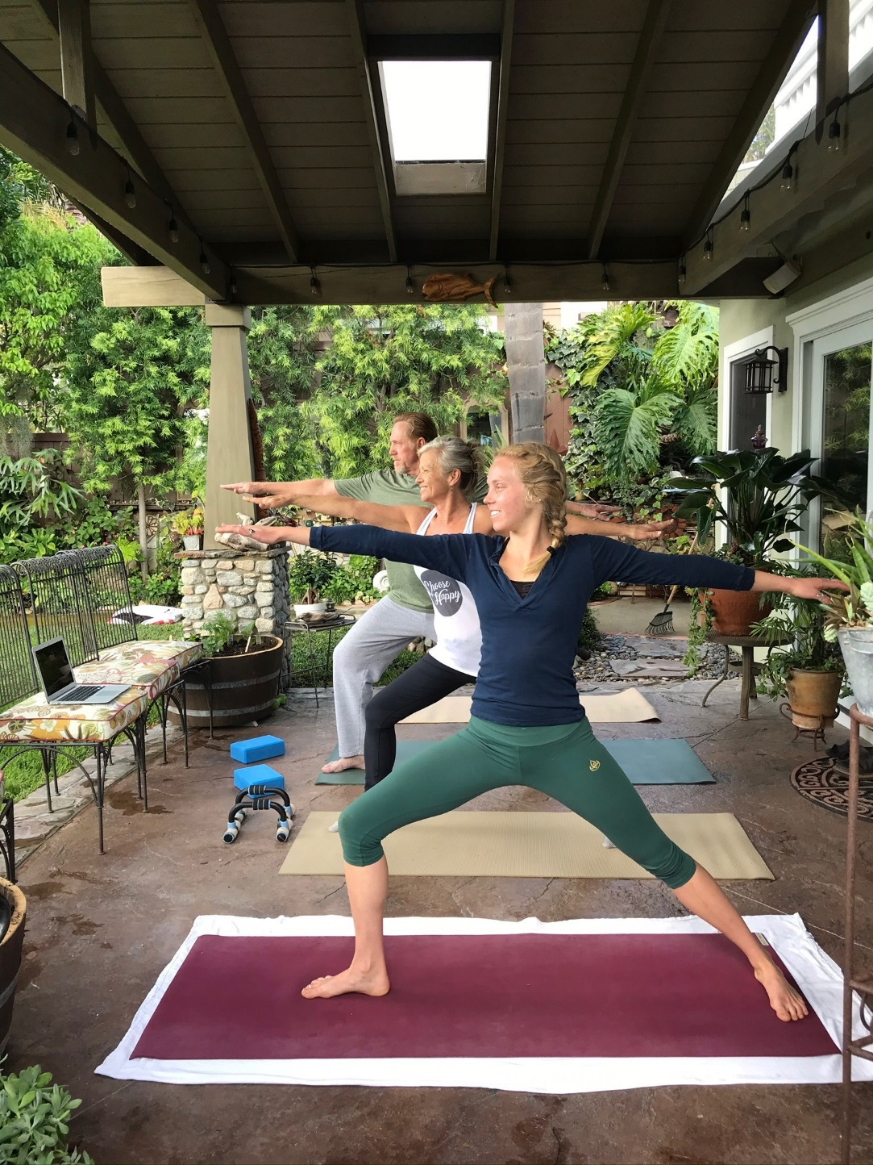
Move More !
… opportunities for self-improvement..?

