Slide 1
Ins & Outs of
OneDrive for Business
Munawar Rangoonwala
X2-7105

Slide 2
What is OneDrive?
OneDrive for Business is a cloud storage application where you can store, sync, and share your work files.
As part of Office 365, OneDrive for Business lets you access, update and share your files from anywhere.

Slide 3
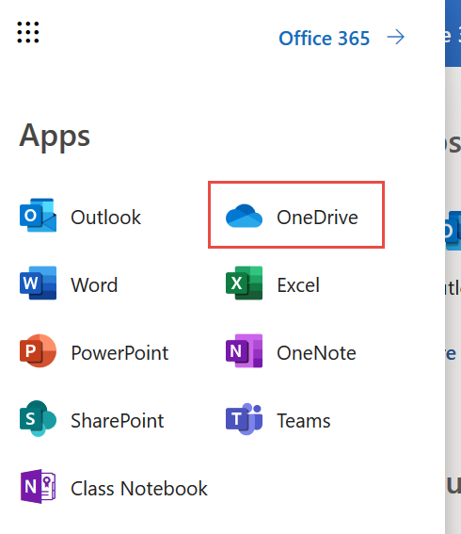
OneDrive in Office 365
OneDrive for Business can be accessed from the App Launcher in O365 Webmail
Demo

Slide 4
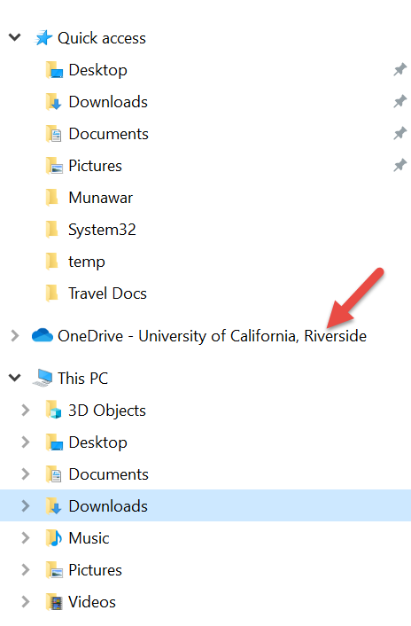
OneDrive Locally
One Drive is integrated within Windows 10 so you can access the files easily in File Explorer
Files can be searched for from the Start menu as well
Demo

Slide 5
Pop Quiz!
To change settings in OneDrive, click on the _____ icon in the web interface.
Gear
Bricks
Question Mark
Grid

Slide 6
Pop Quiz!
An Internet-only file can be accessed offline.
True
False

Slide 7
Uploading Files
You can upload files to your OneDrive by simply dragging them from your computer or using the upload button.
To open or download a file from OneDrive on your computer, select the file, click the More button, and click Download.
Demo

Slide 8
Pop Quiz!
OneDrive storage accepts only files created by Microsoft Applications?
True
False

Slide 9
Pop Quiz!
How do you upload files from the web?
Click Upload at the top of the screen
Click Files at the top of the screen
Click Flow -> Upload
Click New -> Upload

Slide 10
Pop Quiz!
How would you move a file to a folder not visible in the current web-interface view?
Double-Click the file
Open the file and then save it
Right-Click on the file and select Open
Right-Click on the file and select Move to

Slide 11
Pop Quiz!
What automatically happens when you start a new document in Office Online?
A version of the document is stored on your OneDrive
The file is compressed and synced with OneDrive
The Office online software is updated.
The file is shared with all of your colleagues.

Slide 12
Pop Quiz!
What sort of link would you share if you wanted people in your organization to be able to view and edit a document?
View link – UCR Account required
Restricted Link
Edit link – UCR Account required
Edit link – no sign-in required

Slide 13
Thank You!

